Slide 1
Weekly Project Update
Daniil Karbukov
Laurent Bialylew
Wenhao Xie

Slide 2
Work done this week
01
02
03
04
Updated UMLS
Added new classes
Created new class, use case, and sequence diagrams
Added Tour, TourRoute, and TourFeedback classes
Added functions
Updated front end
Implement the CRUD methods for the new classes
Added the new CRUD methods to the admin panel and feedback method after user login page

Slide 3
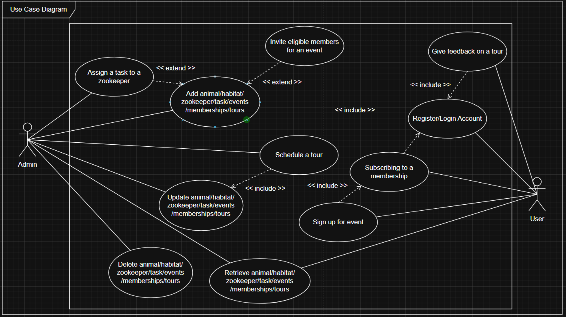
Use case UML

Slide 4
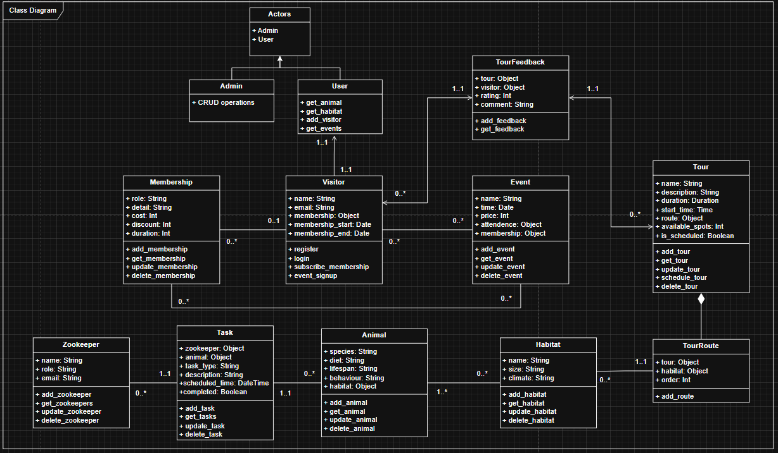
Class UML

Slide 5
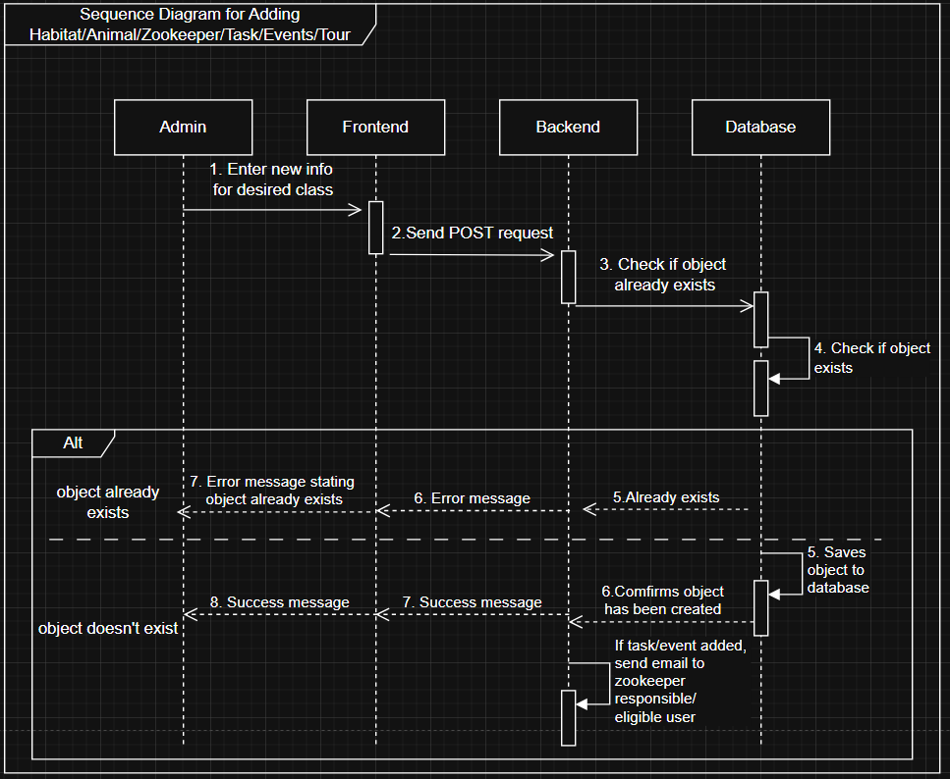
Sequence UML

Slide 6
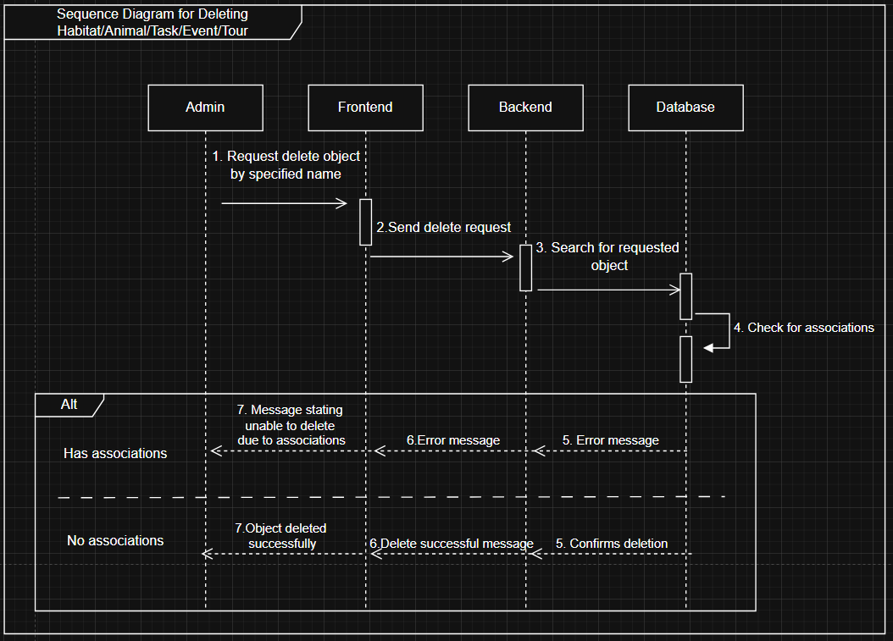
Sequence UML

Slide 7
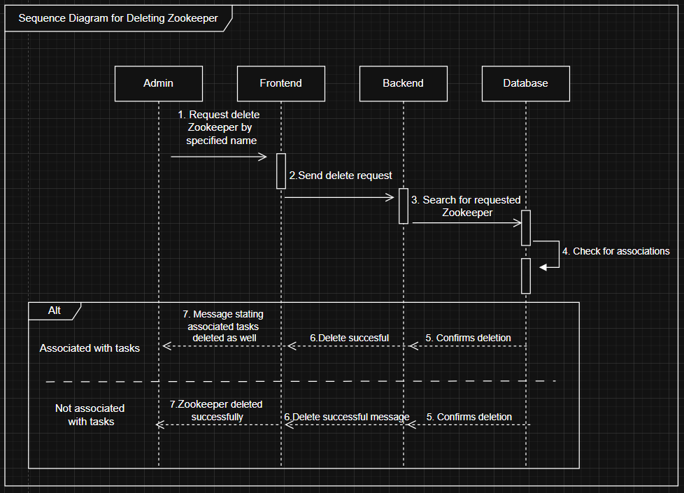
Sequence UML

Slide 8
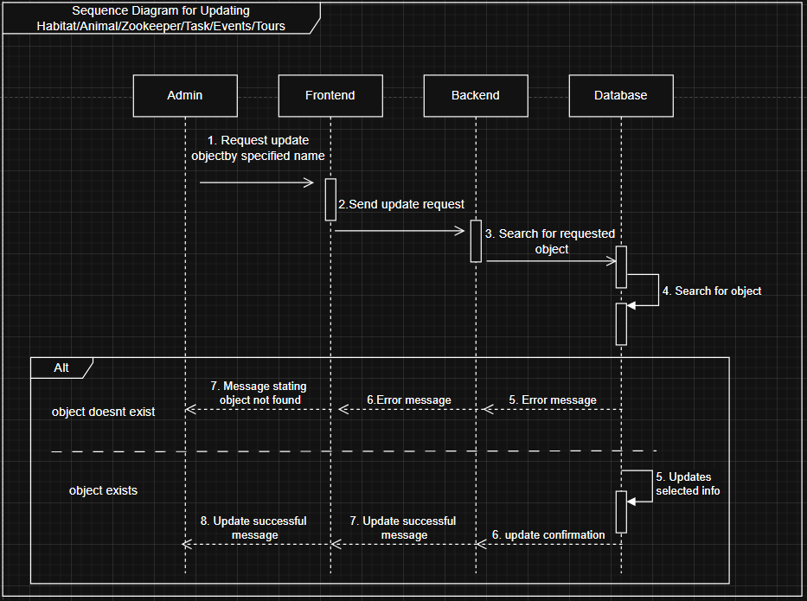
Sequence UML

Slide 9
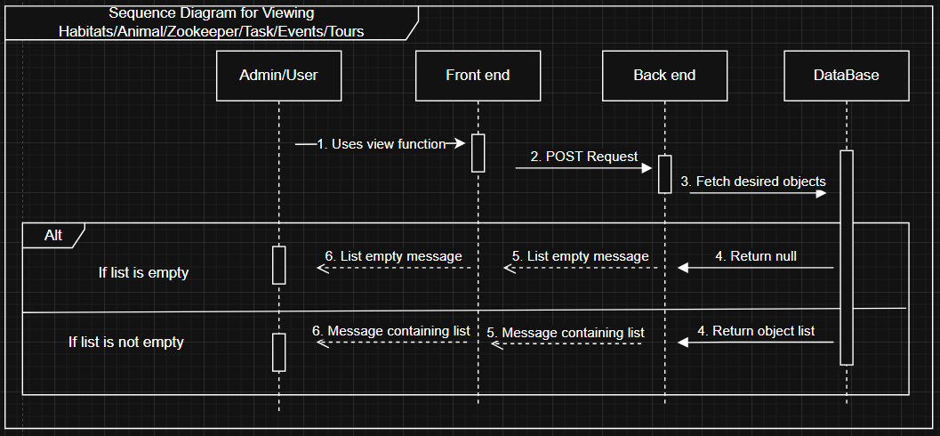
Sequence UML

Slide 10
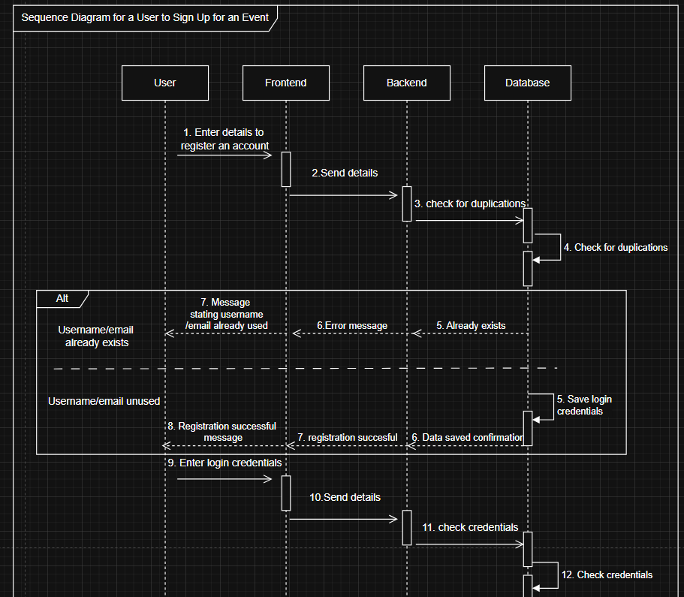
Sequence UML

Slide 11
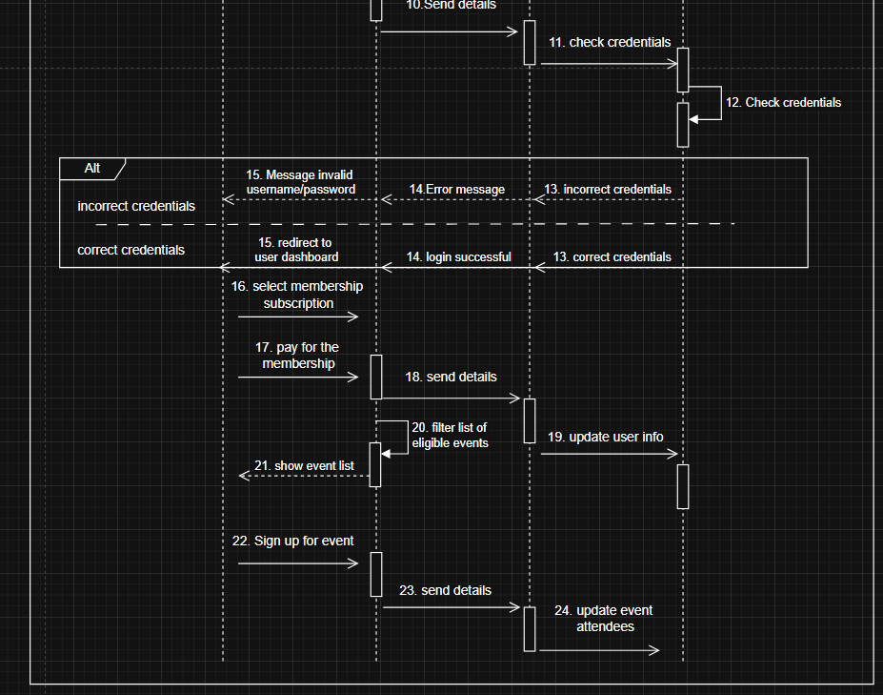
Sequence UML

Slide 12
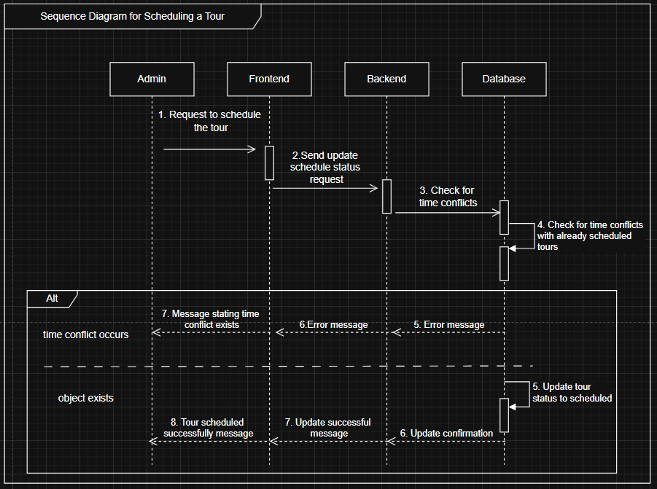
Sequence UML

Slide 13
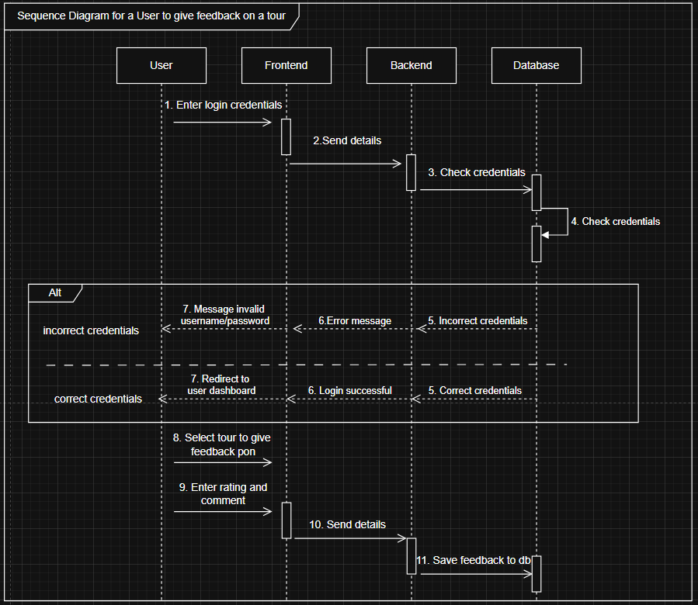
Sequence UML

